Slide 1
Increasing ASEAN Research Competitiveness
Prof. Peter Haddawy
Vice President for Academic Affairs
Asian Institute of Technology

Slide 2

Branding and Excellence
Branding can occur at many levels
Branding in Higher Education requires achieving excellence
Research excellence requires focus
Need objective means to identify our areas of focus
  Research Performance Measurement Network

Slide 3
Example Areas
Nanotechnology
Immunology

Slide 4
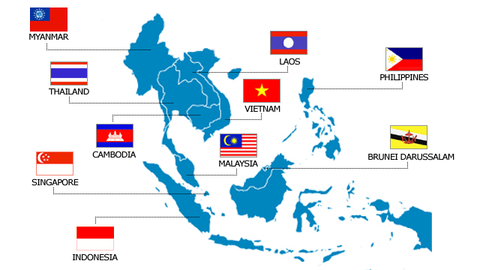
Standing of ASEAN
Japan
China
India
Taiwan
South Korea

Slide 5
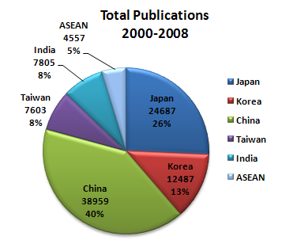
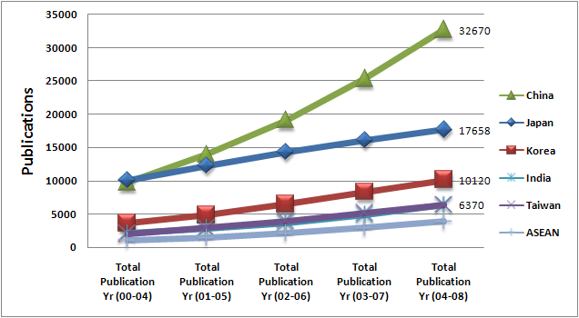
Nanotechnology

Slide 6
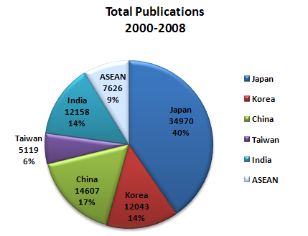
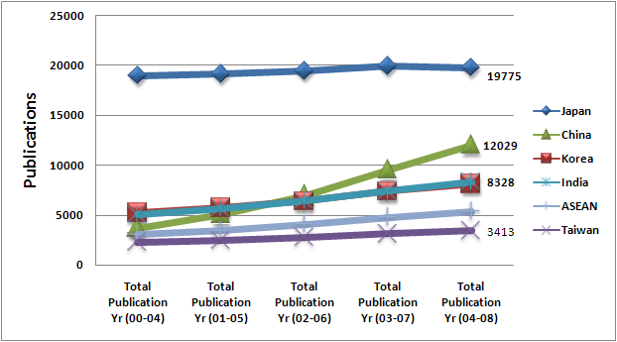
Immunology

Slide 7

Need for Critical Mass
“Not only is it easier to recruit a high-quality faculty member to join a substantial group of similarly
distinguished colleagues but the university can support 10 first-rate chemists much more effectively than it can support one.
University quality, once established at a high level and substantial scale, becomes self-sustaining.”
[J.V. Lombardi, et al, 2004]

Slide 8
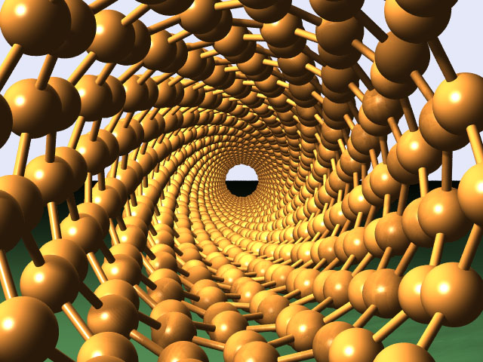
Centers of Excellence
Critical mass of researchers
Efficient use of resources
Enable pursuit of research excellence at international levels
Hubs to coordinate research activity in ASEAN
Points of international linkage (SEA-EU-NET)
Promote areas of importance to ASEAN

Slide 9
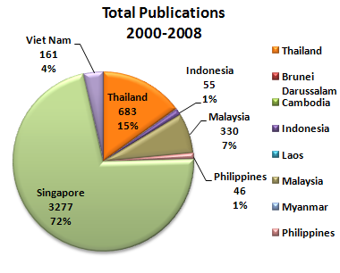
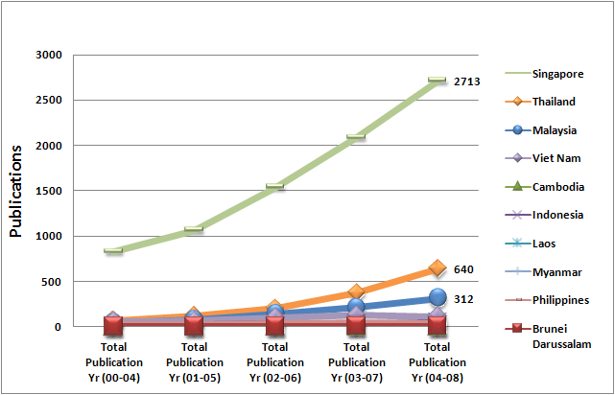
Nanotechnology
Publications

Slide 10
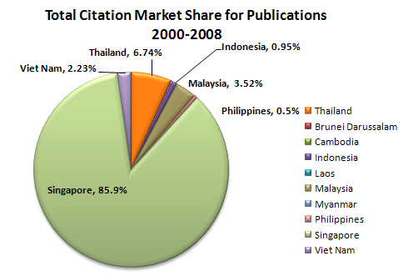
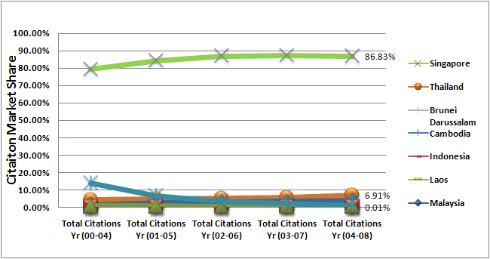
Nanotechnology
Citations

Slide 11
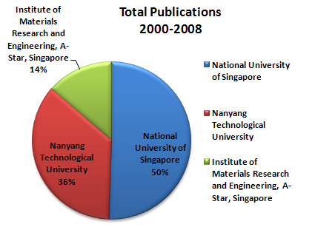
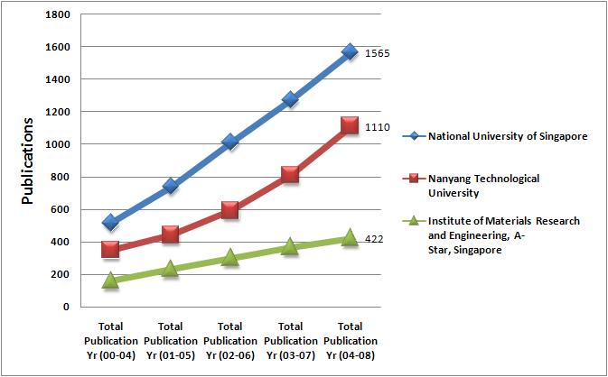
Nanotechnology: Singapore
Publications

Slide 12
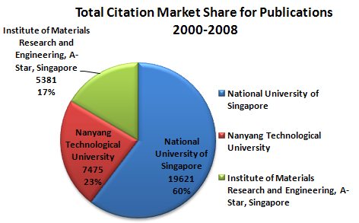
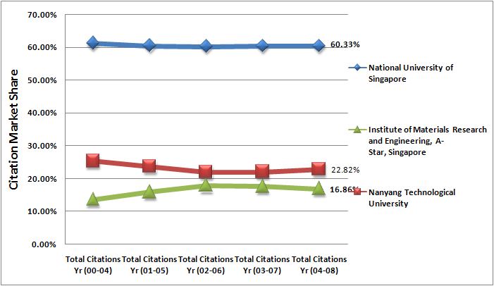
Nanotechnology: Singapore
Citations

Slide 13
Top Researchers In ASEAN
Subject Area: Nanotechnology
Junior Researcher

Slide 14
Top Researchers In ASEAN
Subject Area: Nanotechnology
Author | Current Affiliation
Chua, S.J. | National University of Singapore
Lee, J.Y. | National University of Singapore, Department of Chemical and Biomolecular Engineering
Wee, A.T.S. | National University of Singapore
Sow, C.H. | National University of Singapore, Department of Physics
Li, C.M. | Nanyang Technological University
Yoon, S.F. | Nanyang Technological University, School of Electrical and Electronic Engineering
Tay, B.K. | Nanyang Technological University, School of Electrical and Electronic Engineering
Shen, Z.X. | Nanyang Technological University, Division of Physics and Applied Physics
Balasubramanian, N. | Nanyang Technological University
Lin, J. | Institute of Chemical and Engineering Sciences, A-Star, Singapore

Slide 15
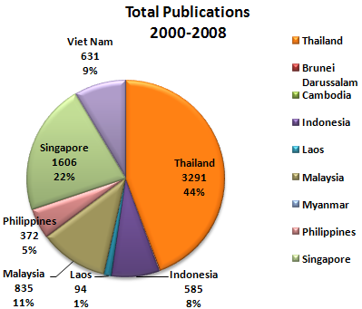
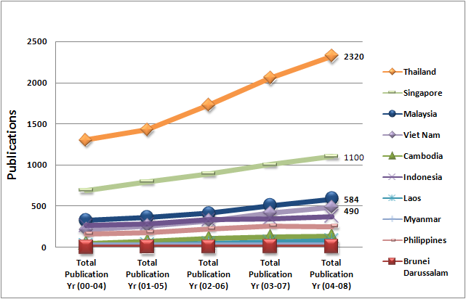
Immunology
Publications

Slide 16
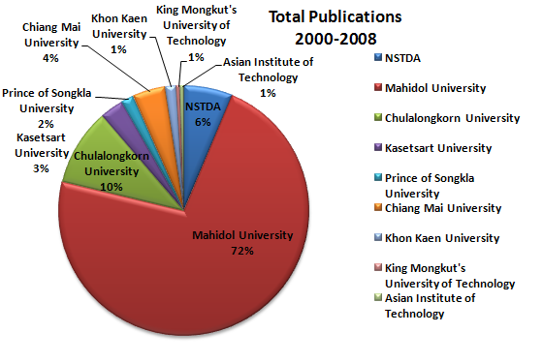
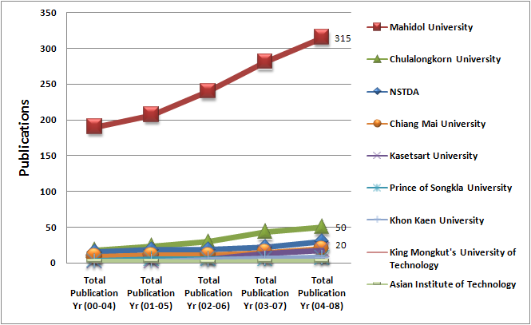
Immunology: Thailand

Slide 17
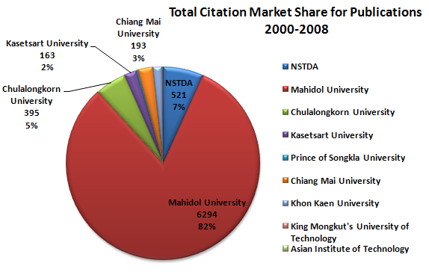
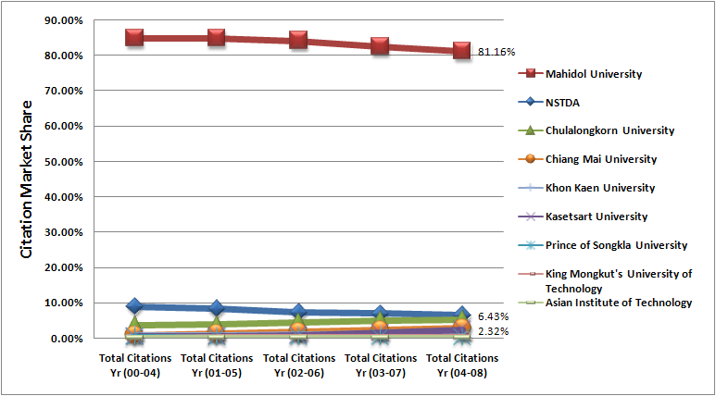
Immunology: Thailand

Slide 18
Top Researchers In ASEAN
Subject Area: Immunology

Slide 19
Top Researchers In ASEAN
Subject Area: Immunology
Author | Current Affiliation
Wiwanitkit, V. | Mahidol University, Faculty of Public Health
Looareesuwan, S. | Mahidol University, Faculty of Tropical Medicine
Day, N.P.J. | Mahidol University, Faculty of Tropical Medicine
Apisarnthanarak, A. | Thammasat University, Division of Infectious Diseases
Kwang, J. | The National University of Singapore
Poovorawan, Y. | Srinakharinwirot University, Department of Microbiology
Phanuphak, P. | The HIV Netherlands Australia Thailand Research Collaboration
Tanticharoen, M. | Thailand National Center for Genetic Engineering and Biotechnology
Tay, J.H. | Nanyang Technological University, School of Civil and Environmental Engineering

Slide 20

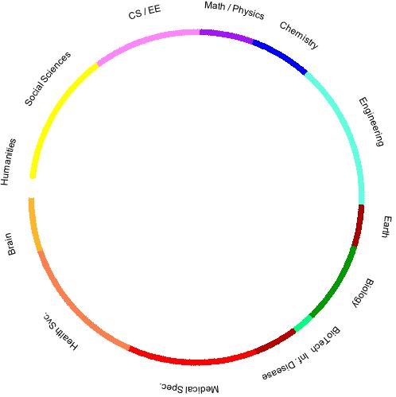

A NEW APPROACH
Data
Partitioning the literature
We start with the Scopus literature database, which indexes over 1.2 million articles per year, and covers a broad set of scientific areas.
This literature is partitioned into ~40,000 highly detailed subject areas.
Math & Physics
Chemistry
Engineering
Earth Sciences
Biology
Biotechnology
Infectious Disease
Medical Specialties
Health Services
Brain Research
Humanities
Social Sciences
Computer Science & EE
# of papers

Slide 21
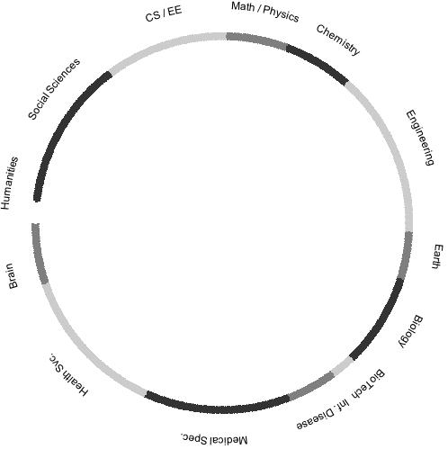
Identifying areas of strength
Additional information
Strengths can be identified for:
  Regions
  Nations
  Universities
Details about strengths:
  Market shares
  Growth rates
  Top competitors
  Top researchers

Slide 22
IDENTIFYING NATIONAL STRENGTHS
Strengths – USA
Strengths – Top 40 Nations
Strengths – Overlaid
Humanities Social Sciences CS / EE Math / Physics Chemistry Engineering Earth Biology BioTech Inf. Disease Medical Spec. Health Svc. Brain
Humanities Social Sciences CS / EE Math / Physics Chemistry Engineering Earth Biology BioTech Inf. Disease Medical Spec. Health Svc. Brain
Humanities Social Sciences CS / EE Math / Physics Chemistry Engineering Earth Biology BioTech Inf. Disease Medical Spec. Health Svc. Brain
US strengths (transparent) are overlaid here on the strengths (dark) from another 40 nations
Source: Klavans & Boyack, “US vulnerabilities in science and engineering,” 10th International Conference on Science and Technology Indicators, Vienna, Austria, Sept. 17-20, 2008

Slide 23
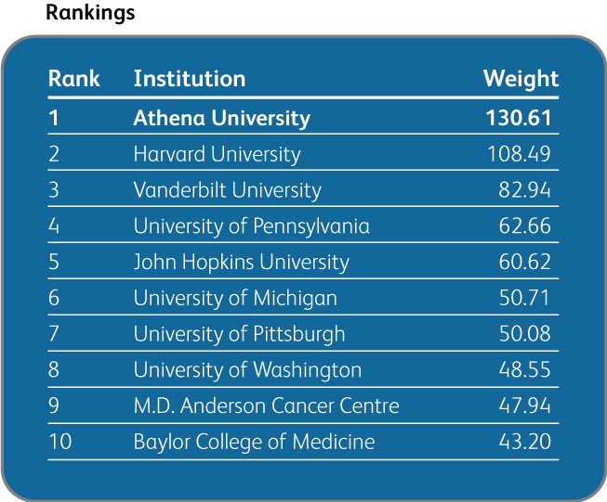
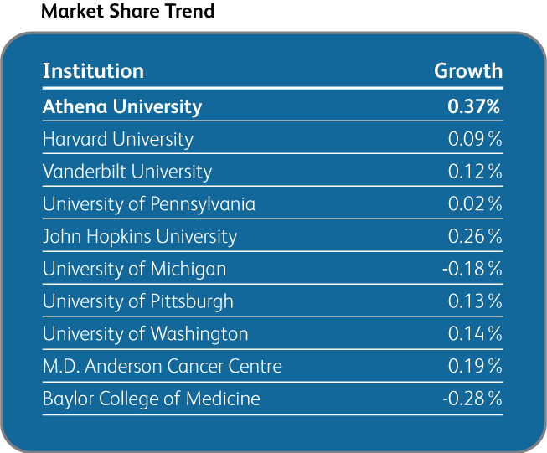
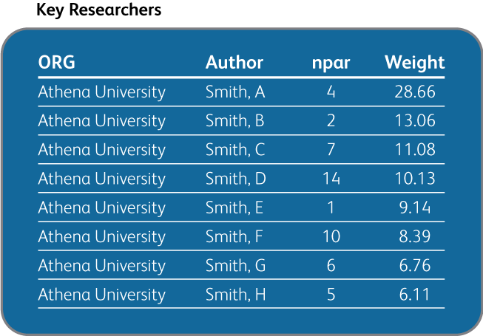
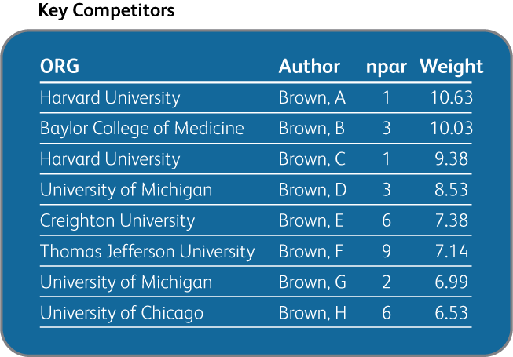
DISTINCTIVE COMPETENCY #26

Slide 24
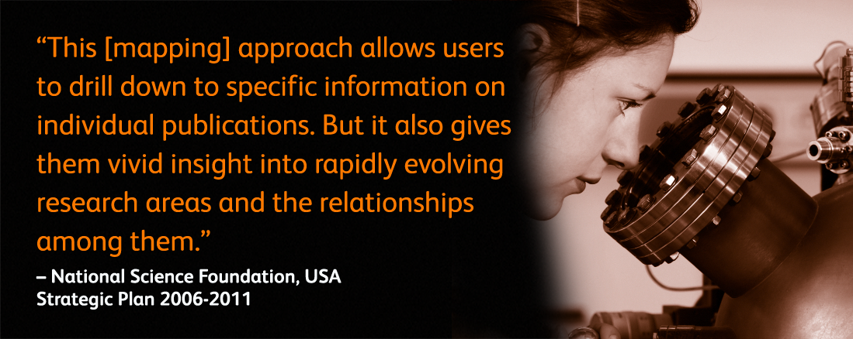

Slide 25
Thank You

Slide 26
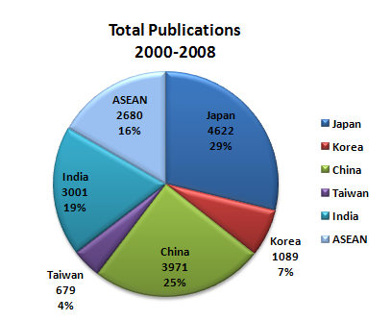
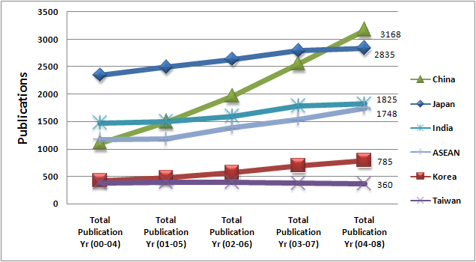
Agriculture & Biological Science

Slide 27
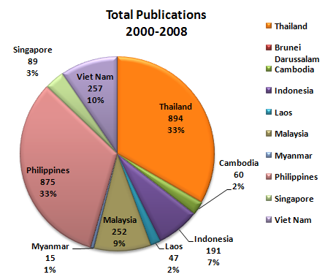
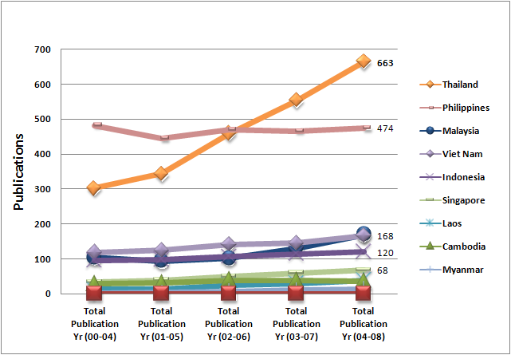
Agriculture & Biological Science
Publications

Slide 28
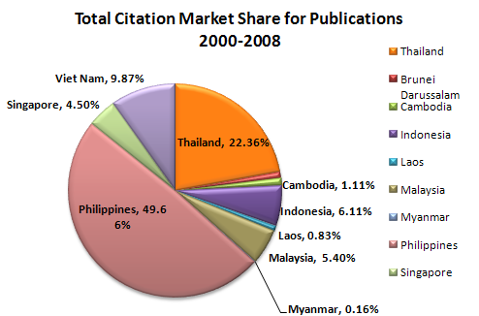
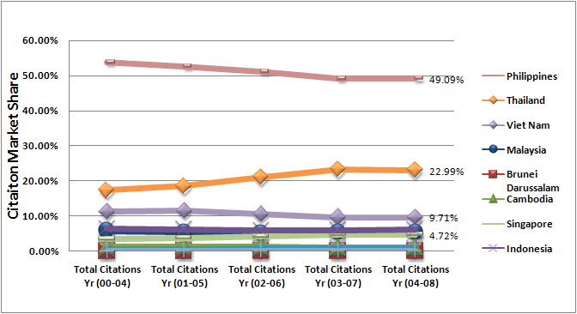
Agriculture & Biological Science
Citations

Slide 29
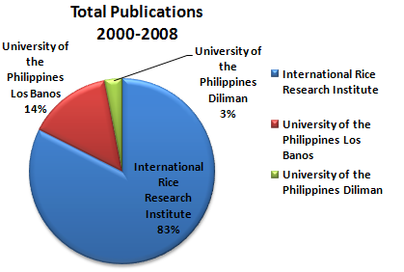
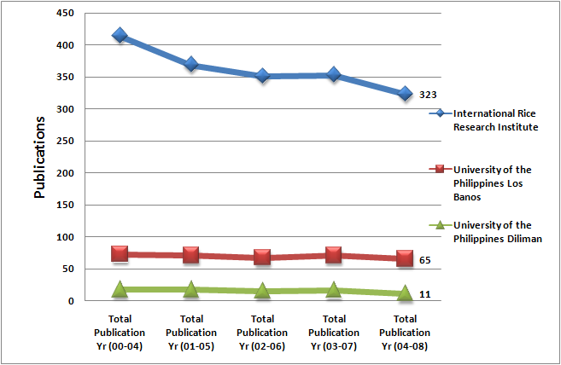
Agriculture & Biological Science: Philippines

Slide 30
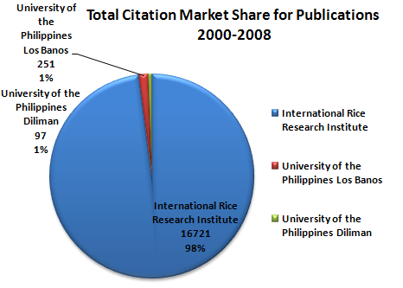
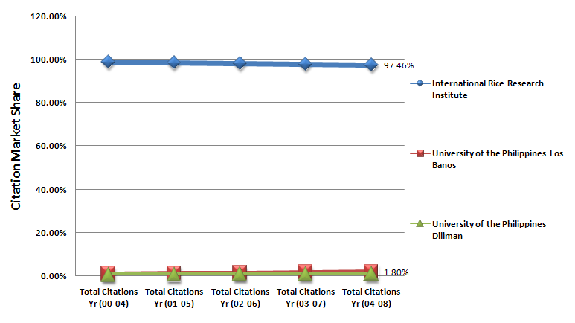
Agriculture & Biological Science: Philippines

Slide 31
Top Researchers In ASEAN
Subject Area: Agricultural and Biological Sciences

Slide 32
Top Researchers In ASEAN
Subject Area: Agricultural and Biological Sciences
Author | Current Affiliation
Wade, L.J. | International Rice Research Institute, Makati Philippines
Peng, S. | International Rice Research Institute, Crop and Environmental Sciences Division, Manila Philippines
Khush, G.S. | International Rice Research Institute, Division of Plant Breeding, Genetics and Biochemisty Los Banos, Philippines
Bouman, B.A.M. | International Rice Research Institute, Crop and Environmental Sciences Division, Manila Philippines
Bennett, J. | International Rice Research Institute, and Biotechnology Division, Manila Philippines
Buresh, R.J. | International Rice Research Institute, Crop and Environmental Sciences Division, Manila Philippines
Tuong, T.P. | International Rice Research Institute, Makati Philippines
Sriroth, K. | Kasetsart University, Department of Biotechnology, Bangkok Thailand
Withyachumnarnkul, B. | Prince of Songkia University, Department of Anatomy, Songkla Thailand
Wanapat, M. | Khon Kaen University, Faculty of Agriculture, Khan Kaen Thailand

Slide 33
Keywords
Nanotechnology
    Nanotechnology, nanotubes, nanowires, nanoparticles, nanorods, nanobiophysics, nanomaterials, nanomedicien, nanostructure, nanotoxicology, nanotextiles, nanoelectromechanical systems, NEMS, nanolithography, nanofabrication, nanoprobes,Nanocomposites, Nanocrystalline Materials, Nanoclusters, Quantum Dots, Quantum Wires, Quantum Wells, Nanoscale Thin Films, Fullerenes, Nanophysics, Nanoelectronics, Nano-Optics, Nanomagnetism, Nanodevices, Nanochips, Nanosensors, Nano-integration, Nanofluidics, Nanomachining, Nanorobotics,
    Nanotribology
Agricultural & Biological Sciences
    Rice, shrimp, rubber, corn, cassava, sugar

